Slide 1
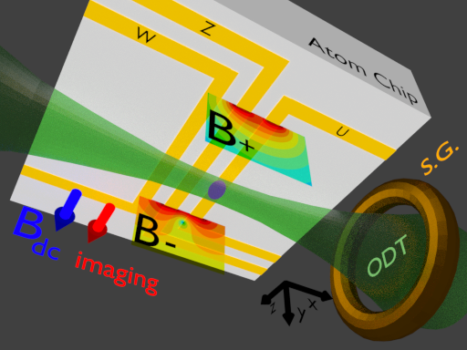





Radiofrequency AC Zeeman Trapping for Neutral Atoms
Drew Rotunno
Adviser: Seth Aubin
William & Mary
June 21, 2021

Slide 2
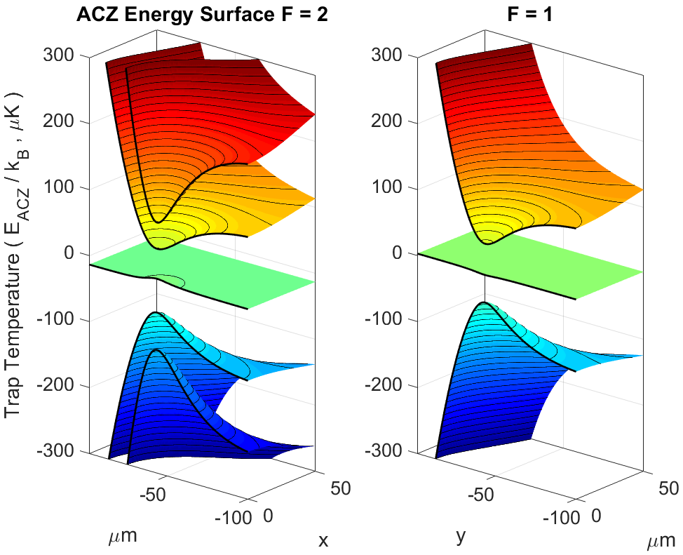
30-second Thesis
What? A new type of atom trap using AC Zeeman energy
Why? Trapped atom interferometry + cool new experiments
How? Using radiofrequency (RF) currents in atom chip wires,
to create minima in circularly polarized B₊ /B₋ near fields,
which generate AC Zeeman trapping potentials for atoms.
DC Zeeman uses B_{DC} minimum
AC Zeeman uses B₊/B₋ minimum
Left- and right- handed rotating magnetic fields

Slide 3
Table of contents
Motivation
Introduction
AC Zeeman Theory
ACZ Force
ACZ Trapping
Trap simulation
Summary / Outlook

Slide 4
Table of contents
Motivation – Atom Interferometry
Introduction
AC Zeeman Theory
ACZ Force
ACZ Trapping
Trap simulation
Summary / Outlook
Future first, then how we get there
Light on details – interferometry is hard!
ACZ trap is useful in other contexts too

Slide 5
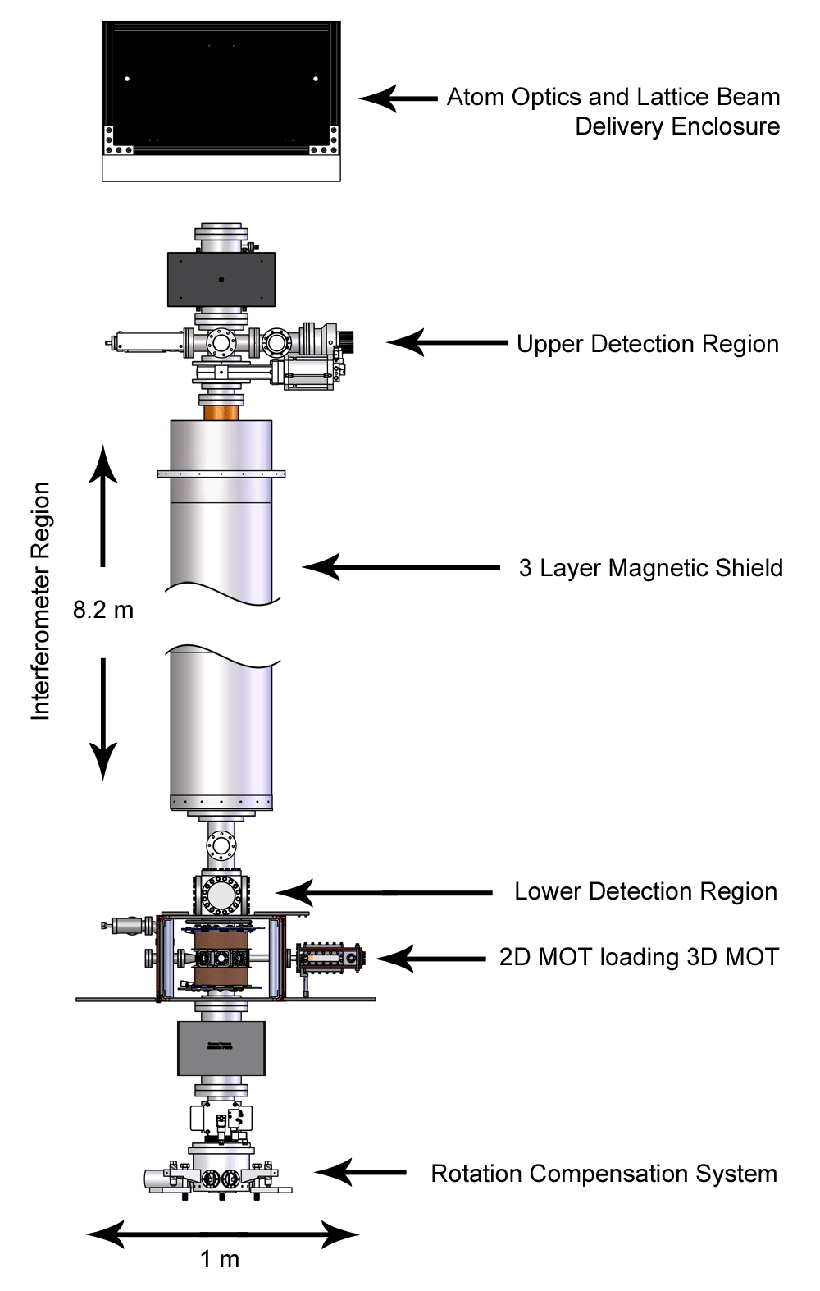
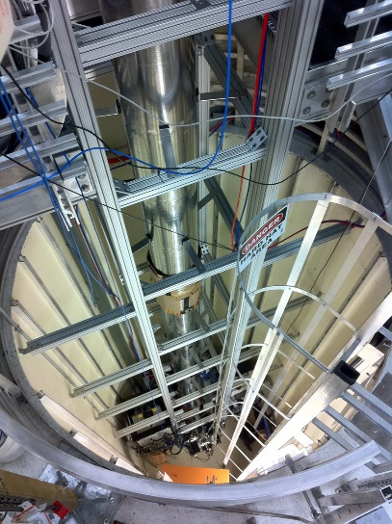
Motivation: Atom Interferometry
Used to make VERY precise measurements ( mc² = E = hf, atoms are clocks of ΔE)
Probe gravity, fundamental constants, acceleration, rotation, energy gradients
Measure phase diff. between superposition ‘arms’ of the interferometer (island time)
Coherent splitting and recombination required for read-out
It doesn’t work if you look at it!
Many use ballistic atom clouds in momentum superpositions
We propose to use trapped atoms in spin superpositions
Measurements are local, and integration time can be longer
This thesis is a proof-of-concept for this spin-targeting trap
Ex. Kasevich 10 m
tower @ Stanford

Slide 6
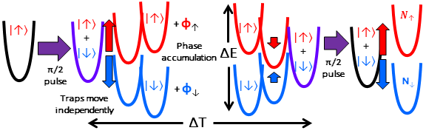
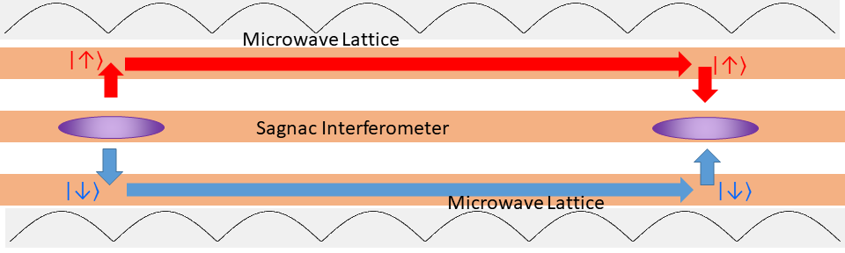
Trapped AI
Mach-Zender / Ramsey method
using trapped atoms
Idea: Fully independent spin traps
or one-parameter separation
Shuangli Du (thesis in 1 month) has demonstrated a spin-push interferometer in an optical dipole trap (ODT)
Add axial μw lattice, enclose area, make a Sagnac interferometer

Slide 7
Today: AC Zeeman trapping
Today’s thesis is a demonstration of the first AC Zeeman trap
(Some cavity demos, beam deflecting, no traps against gravity)
Targeting individual states takes microwaves (next gen)
Good interferometers need a new geometry (3-wires +)
AC Zeeman can slot into other experiments as a spin-selecting effect
(already energy shifting for trapped ions, and adiabatic trapping for atoms)

Slide 8
Table of contents
Motivation
Introduction – Apparatus, Atoms, and you!
AC Zeeman Theory
ACZ Force
ACZ Trapping
Trap simulation
Summary / Outlook
So physicists and my parents know what I’m talking about

Slide 9
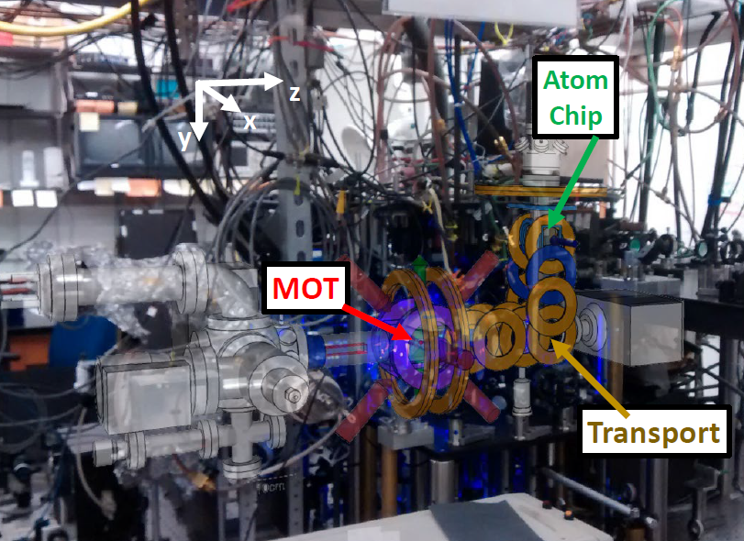
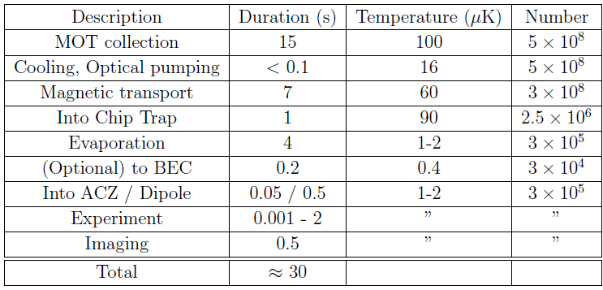
Intro: Our Atom Experiment
Cold atoms, to < 1 μK above abs. 0
Slow, spherical atoms in dilute gas
Bose-Einstein condensation (BEC)
In vacuum, affected only by
Photons (energy ℏω or hf)
Laser beams through atom clouds
Electric (E) and magnetic (B) fields
From charges and currents in conductors
Gravity
A typical cycle is 30 seconds

Slide 10
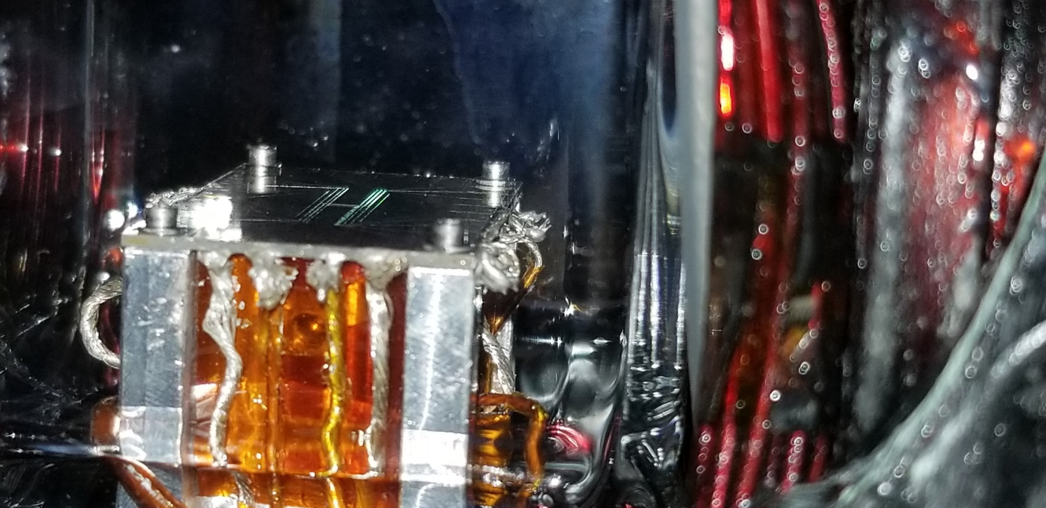
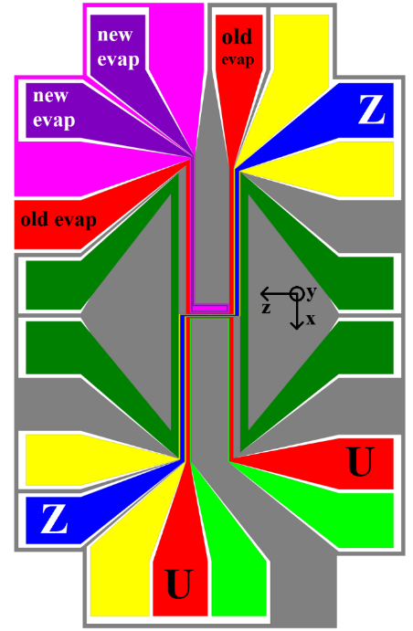
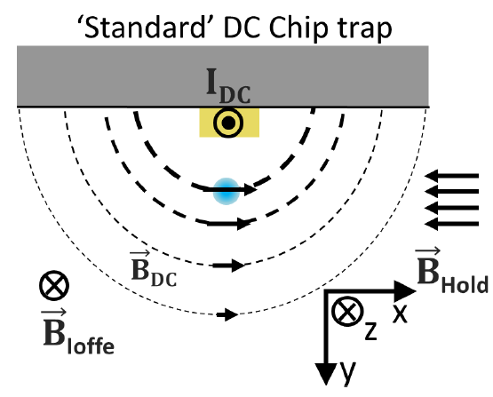
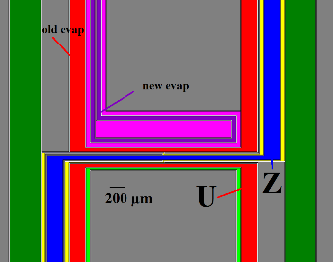
Atom Chip
Carries DC, AC currents on metal traces
DC on Z-wire plus B_{hold} make trap
Vector cancellation at one point
“Ioffe” field B_{DC} is a ‘cork’ in the bottom
Sets Zeeman splitting too
RF (MHz) on U-wires
For evaporation (very common)
In multiple wires for ACZ trapping (new)
Microwaves (GHz) have poor coupling
Design broadband for next gen (more later)
(credit: C. Fancher)

Slide 11
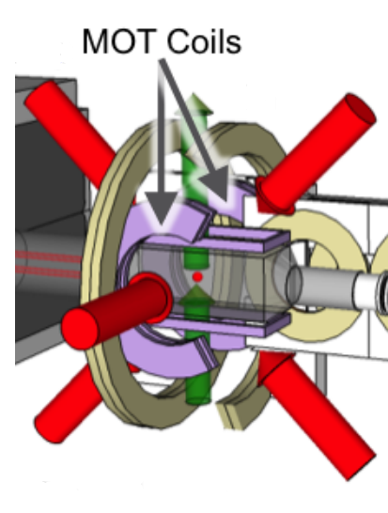
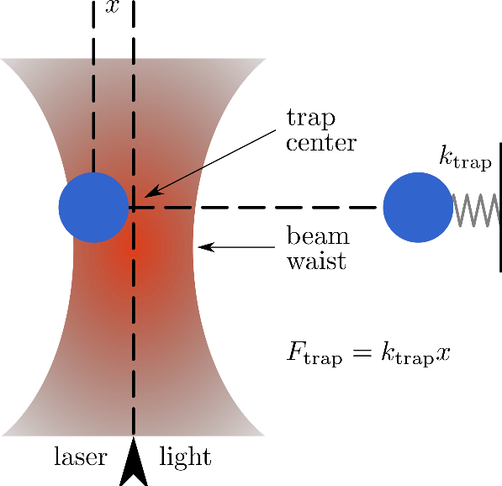
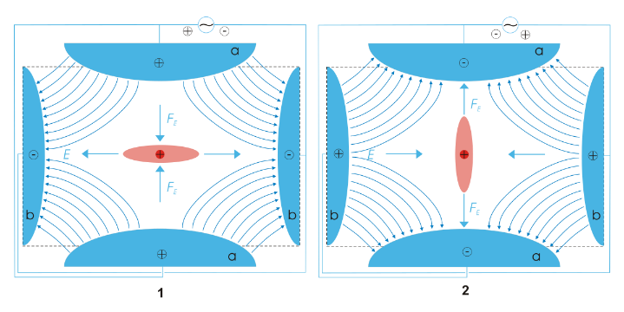
More traps to contrast
Magneto-Optical Trap (MOT)
Light dopppler cools, B confines
Only low-field seeking m_{F}
Optical Dipole Trap (ODT)
Atoms in laser focus (we use 2)
Traps ALL atoms, not spin-selective
DC Atom Chip Trap
As discussed, we evaporate in one
Only low-field seeking m_{F}
Quadrupole Ion trap (RF/Paul trap)
Uses electric fields for ions
Others: Time-orbiting potential (TOP), optical lattice, 2-D MOT, MOT-on-a-chip
Credit: A. Ziltz, M.Ivory
This Photo from the Optical Tweezers wiki page is licensed under CC BY-SA
Credit: C. Fancher
This Photo by Unknown Author is licensed under CC BY-SA

Slide 12
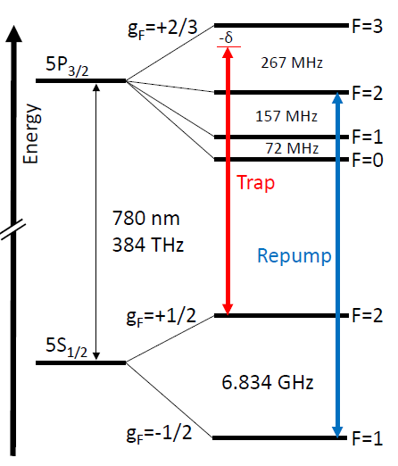
Rubidium Atoms (for parents)
Rydberg states
[ 37 p⁺ + 50 n⁰ ] + 37 e⁻ (isotope 87)
Electrons paired in “orbitals”… 1 on its own
States are shapes where electrons are found
Each state energy is quantized
Photons are an oscillating EM field
Atom state + photon → new state
“Optical” (E) transitions – red light 780 nm
“Hyperfine” (B) transitions – Microwaves
“Intra-manifold” (B) radiofrequency (RF)
Rydberg states also have (E) RF transitions

Slide 13
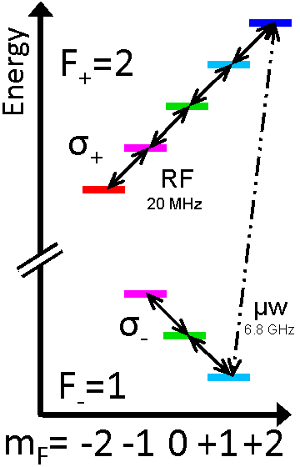
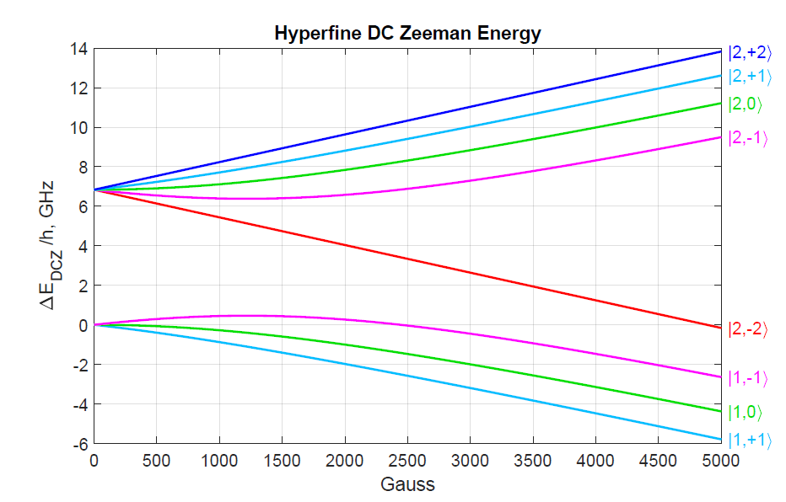
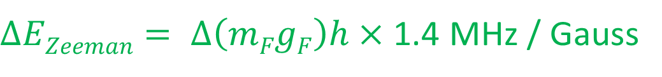
DC Zeeman for RF transitions (m_{F} / σ± )
g_{F} = +½
Paschen-Back region
5S_{½}
Zeeman region
g_{F} = -½
$∆EZeeman= ∆\left(mFgF\right)h×$ 1.4 MHz / Gauss
I + S, not F

Slide 14
Table of contents
Motivation
Introduction
AC Zeeman Theory
ACZ Force
ACZ Trapping
Trap simulation
Summary / Outlook
What happens when we drive transitions?
Atoms + photons = New mixed states
2-level and 5-level

Slide 15
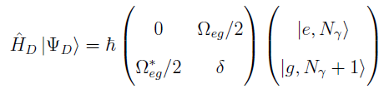
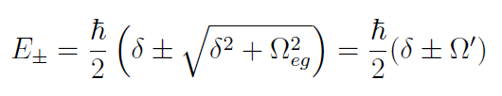
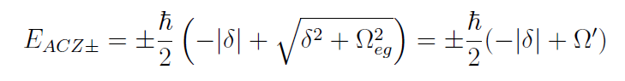
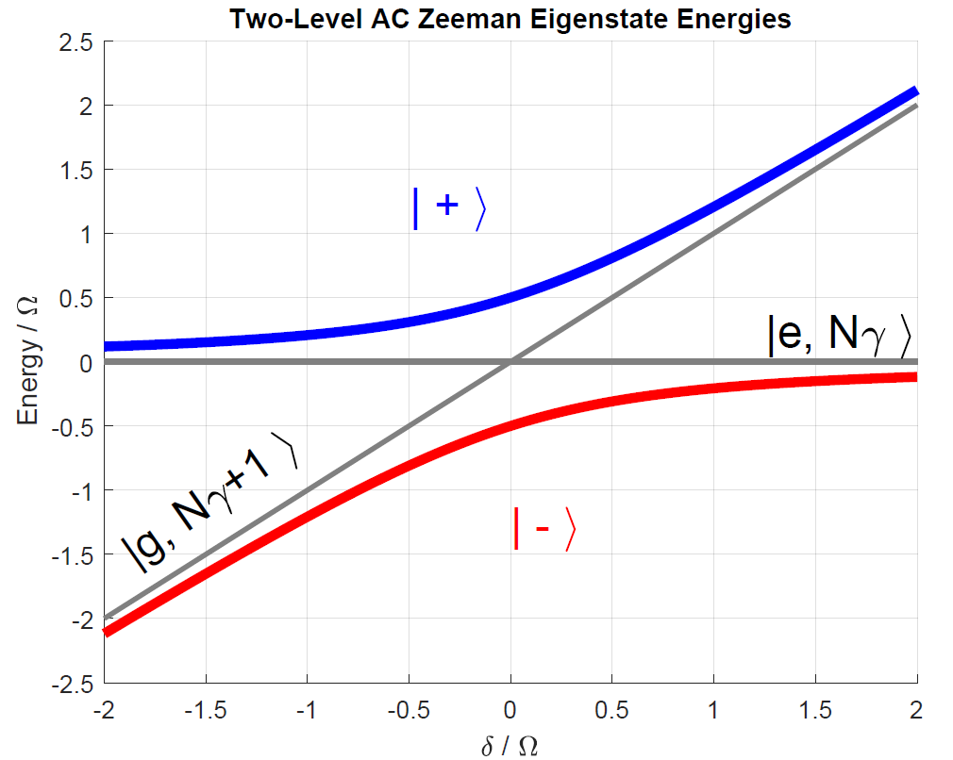
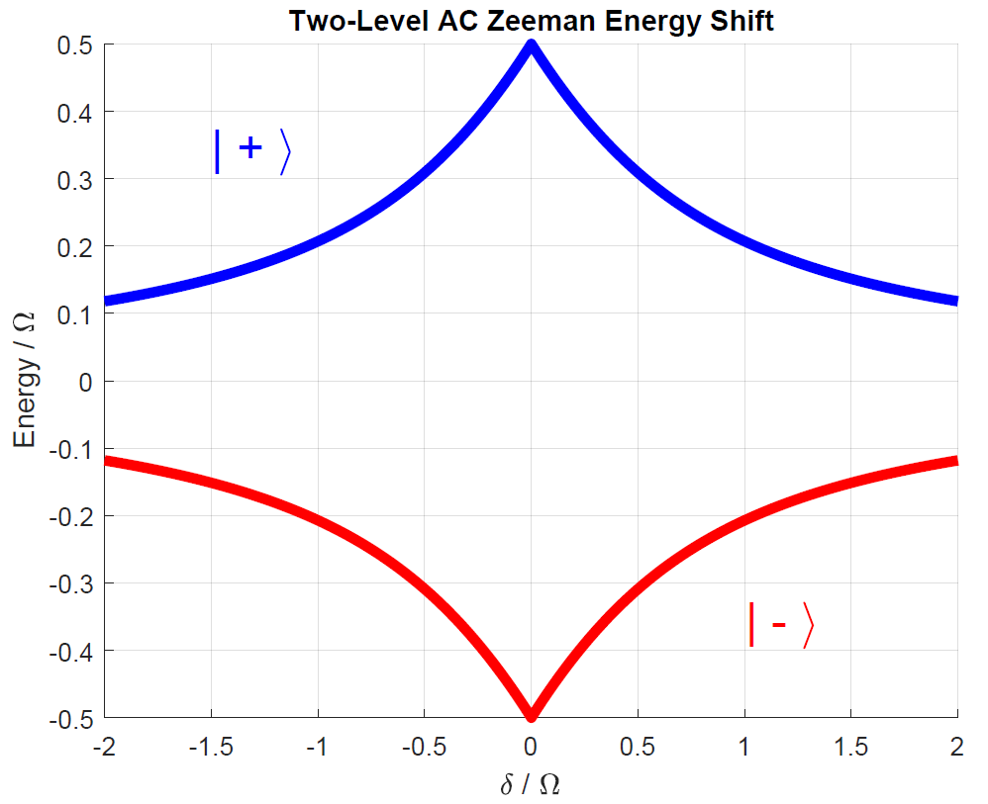
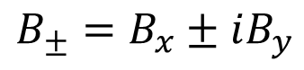
AC Zeeman theory (2-level)
$$B_{±}=B_{x}±iB_{y}$$
F=2
F=1
Not in RF
Dressed Atom basis
Rabi Frequency
Diagonalize → new Eigen states
Added ACZ Energy
Population
δ = ω_{RF} - ω_{eg}

Slide 16
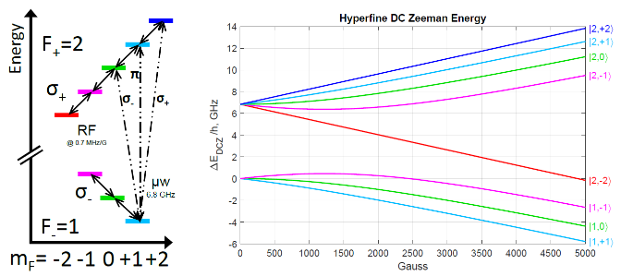
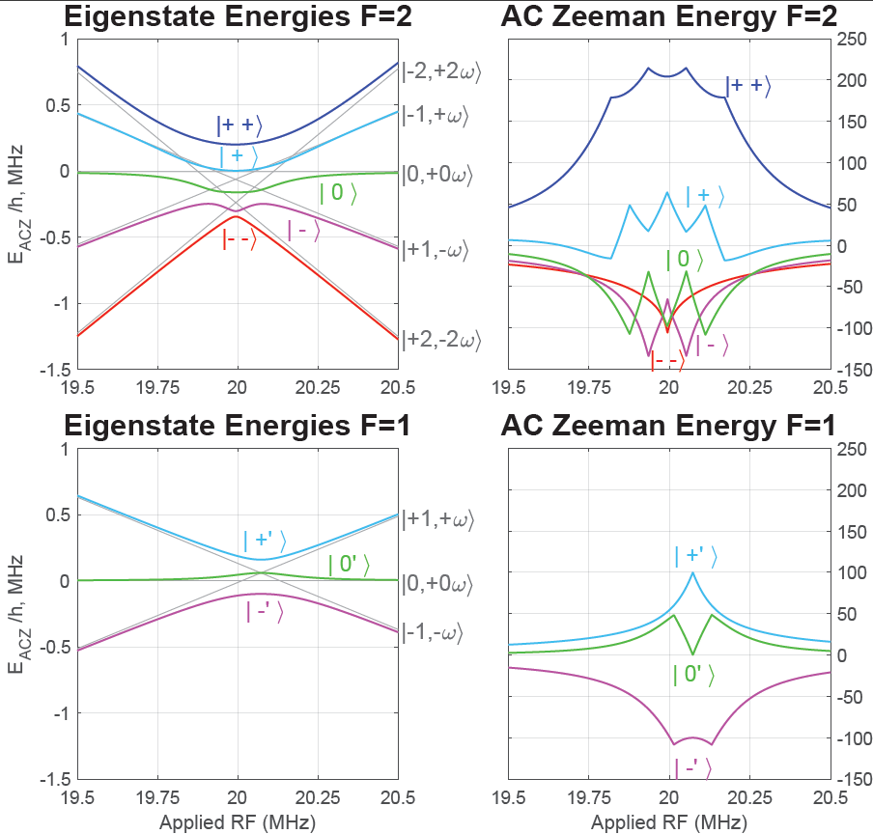
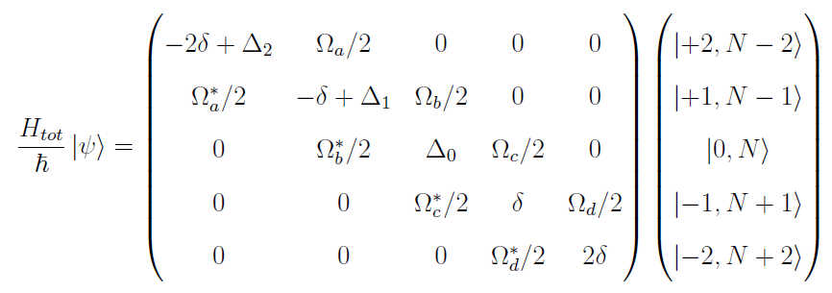
Five- and Three-level ACZ
AC Zeeman energy for the whole manifold has to be calculated
Four (two) transition resonances
State |++⟩ is our trap target
E_{ACZ} /h, kHz
Ω₀/2π = 500 kHz
E_{ACZ} /h, kHz

Slide 17
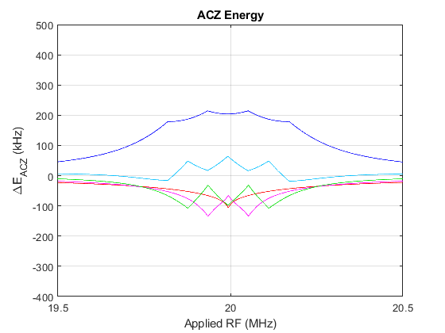
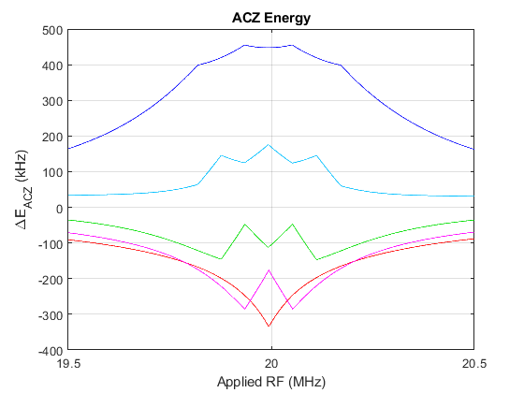
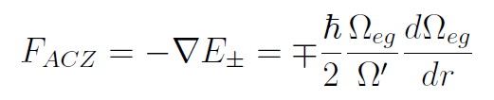
High-field and low-field seeking
When energy has a gradient over space, a force is created
Atoms “want to go” where their energy is lower.
If energy raised by interaction, low-field seeking
If energy lowered by interaction, high-field seeking
Gradients near chip… test ACZ force
Ω₀/2π =
500 kHz
Ω₀/2π =
1 MHz

Slide 18
Table of contents
Motivation
Introduction
AC Zeeman Theory
ACZ Force – Push or Pull
ACZ Trapping
Trap simulation
Summary / Outlook
Gradients in energy, can we measure the force?
Cover all states in F=2 to check the theory

Slide 19
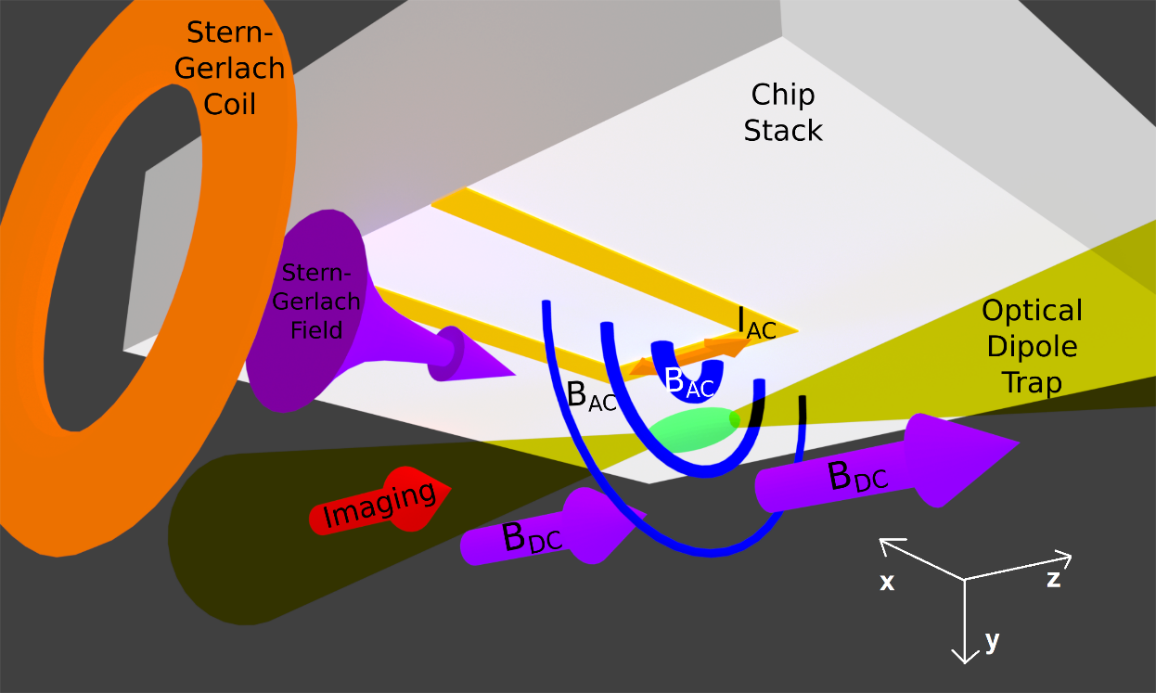
ACZ Force experiment
Atoms in ODT just under chip
One chip current makes horizontally polarized B field
B_{x} = (B₊ + B₋) /2
with vertical gradient
Resonance: 8.4 MHz @ 12 G

Slide 20
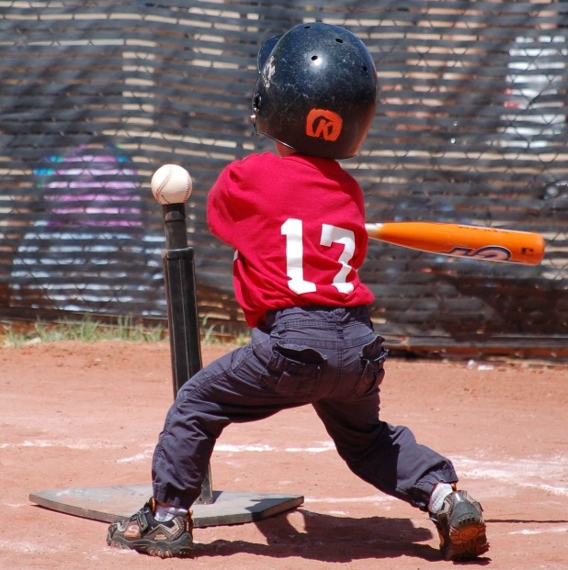
Baseball analogy (… more like T-ball from ODT)
Put ball on the tee
Remove Tee
Swing (either way)
Make contact
Follow through
Let it fly
Populate any m_{F} state
Drop from ODT
Sweep f_{RF} from off res. (100 µs)
Hold f_{RF} at test freq. (500 µs)
Sweep back to start m_{F} (100 µs)
Observe change in pos. after a time-of-flight (≈12 ms)

Slide 21
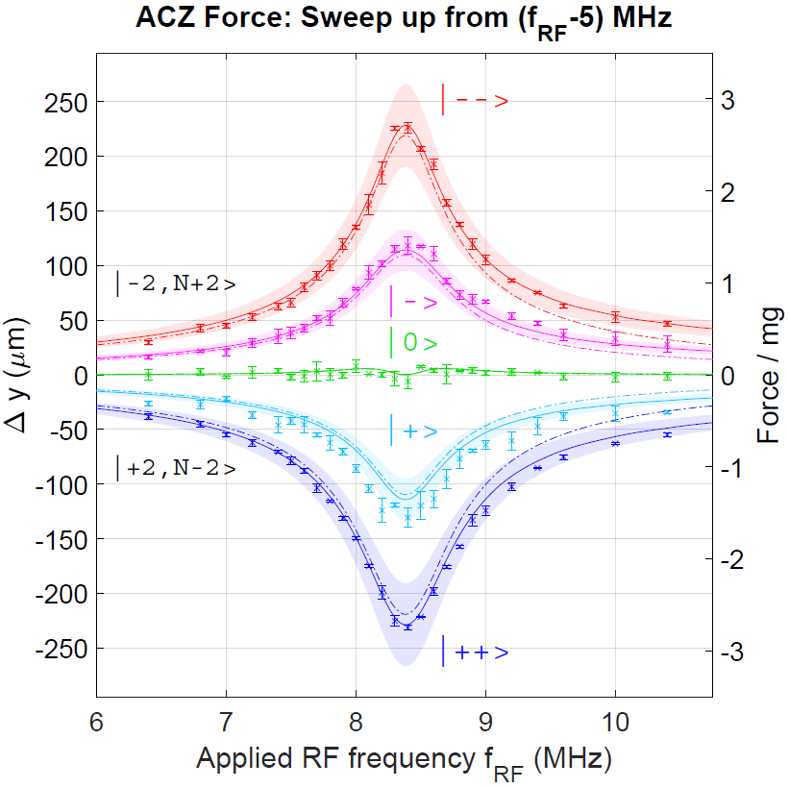
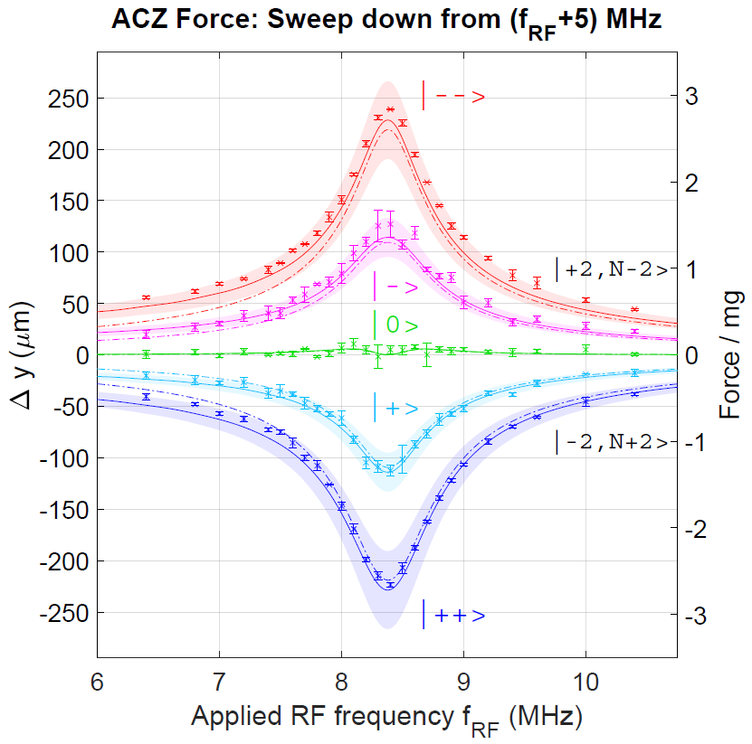
AC Zeeman Force Experiment (push/pull)
Ω₀/2π ≈ 1 MHz
∇Ω₀/2π ≈ 10 kHz / μm

Slide 22
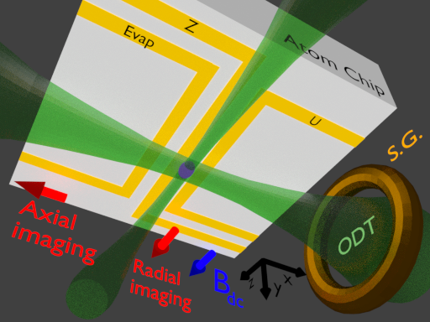
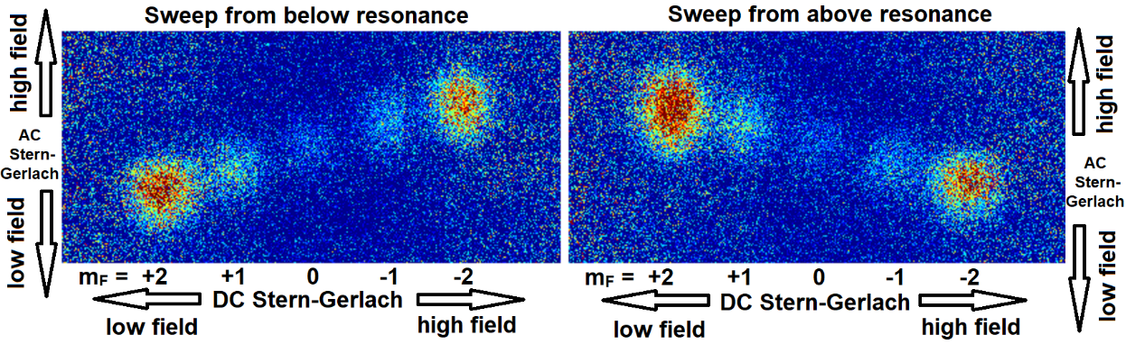
AC Stern-Gerlach
DC stuck High/Low by m_{F}
AC either High/Low by initial detuning and state
Populate all m_{F} states
Drop from ODT
AC SG separates vertically
from above resonance
or below
DC SG separates horizontally
Observe

Slide 23
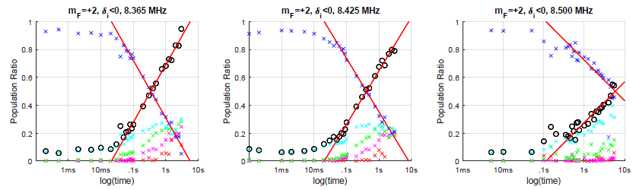
Hold time “decoherence” as state mixing
Observe clouds feeling ACZ in ODT for long times
See when there’s as much in other ( o ) states as the starting ( x )
Look for trends over hold frequency detuning and power
No theory curves for us yet
T_{cross}

Slide 24
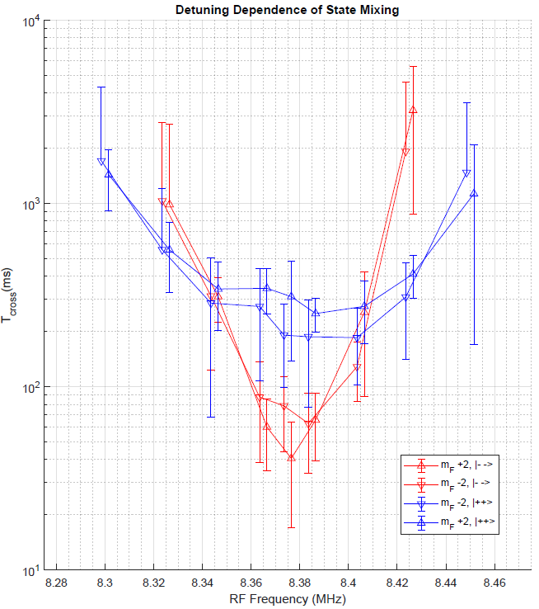
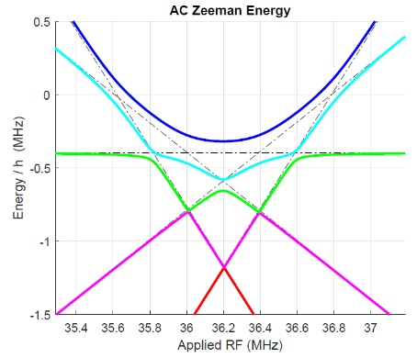
State mixing over Detuning
Displays resonance:
Low times for strongest force
Higher times with detuning
|--⟩ and |++⟩ (red and blue) have widths corresponding to energy structure (4 tran.’s vs. “1”)
Populating |--⟩ or |++⟩ from either side (m_{F}=+2/-2) is the same

Slide 25
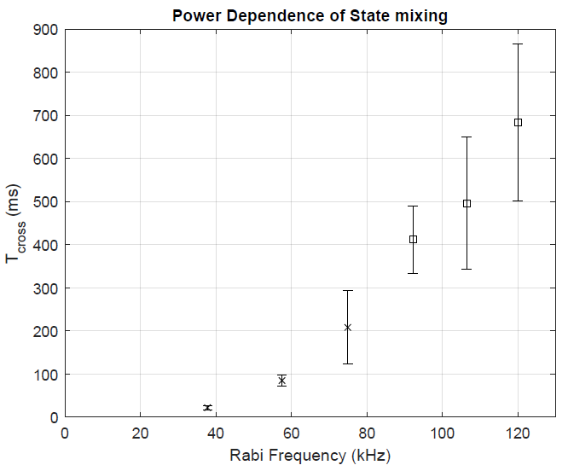
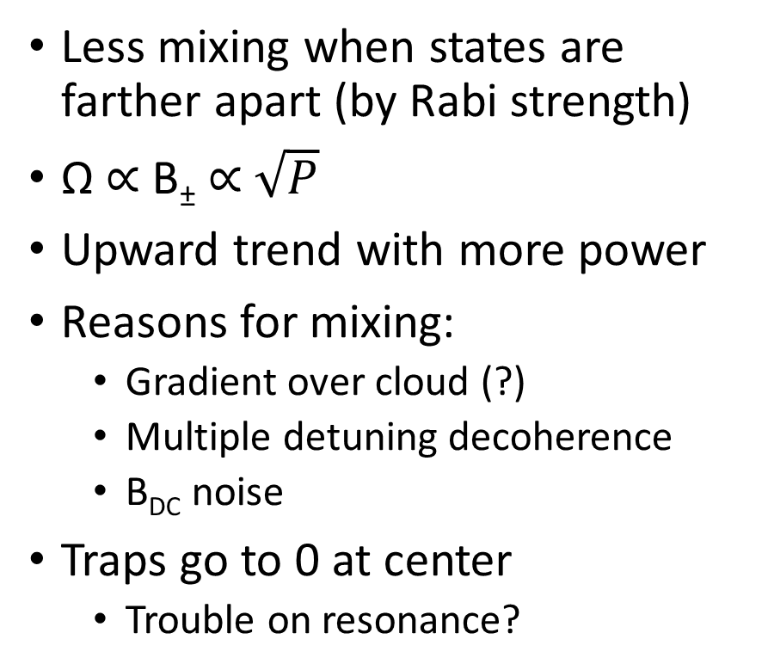
State mixing over field strength
Less mixing when states are farther apart (by Rabi strength)
Ω ∝ B± ∝ $\sqrt{P}$
Upward trend with more power
Reasons for mixing:
Gradient over cloud (?)
Multiple detuning decoherence
B_{DC} noise
Traps go to 0 at center
Trouble on resonance?
detuning δ = 0

Slide 26
Table of contents
Motivation
Introduction
AC Zeeman Theory
ACZ Force
ACZ Trapping – method, results, and some tricks!
Trap simulation
Summary / Outlook

Slide 27
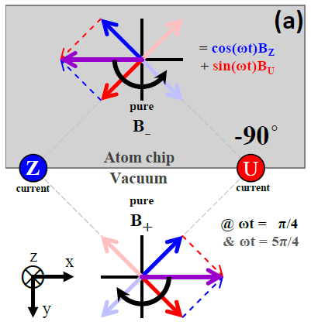
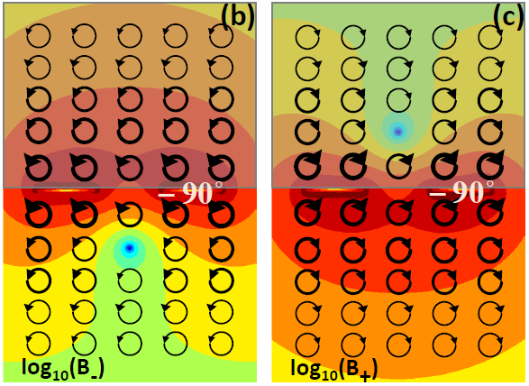
Trap pedagogy
Two chip traces, with same RF
Out-of-phase with each other
Vector rotates over time
Looking at circular polarizations:
At two points, B₊ or B₋ are PURE
So the opp. B₋ or B₊ are a ZERO
Elliptical MOST places ( + and - )

Slide 28
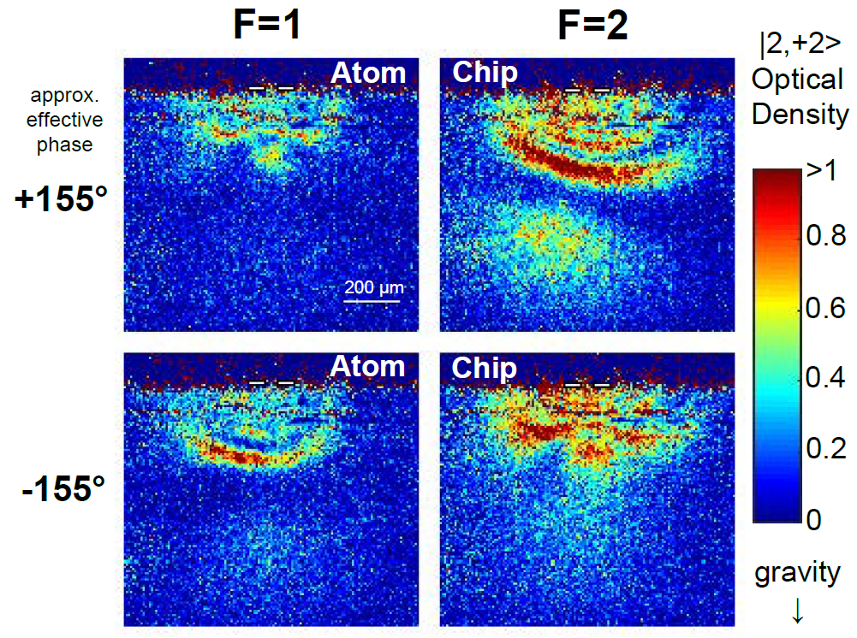
Rabi Maps for Trapping fields
-155° (estimated)
…just add power

Slide 29
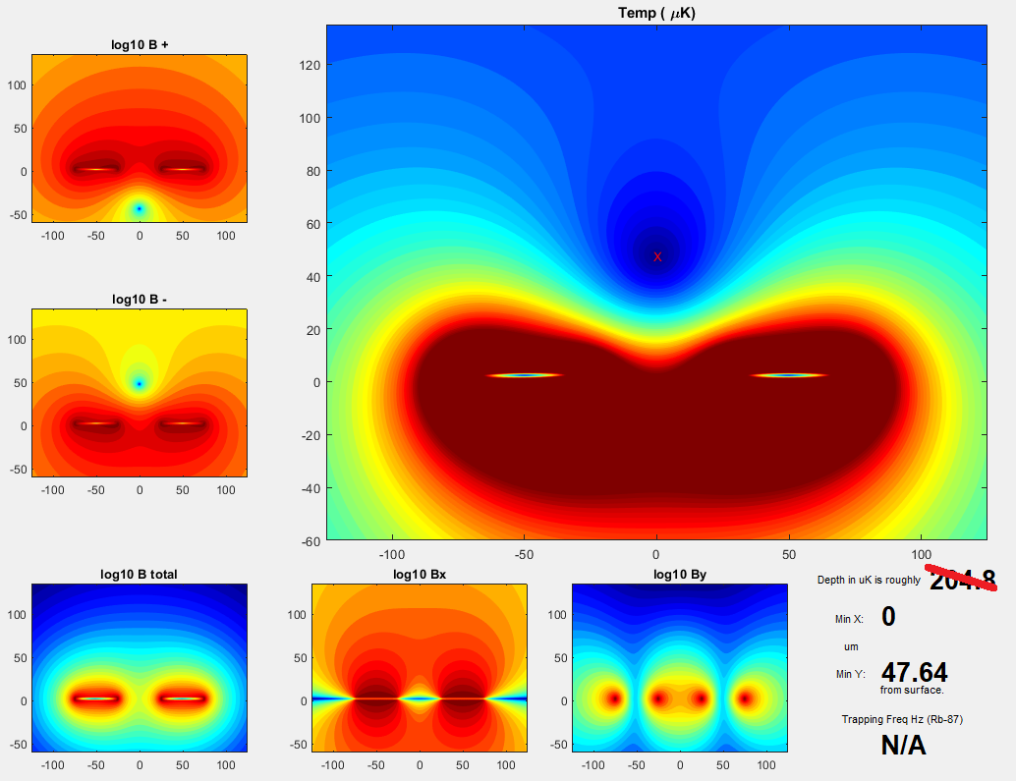
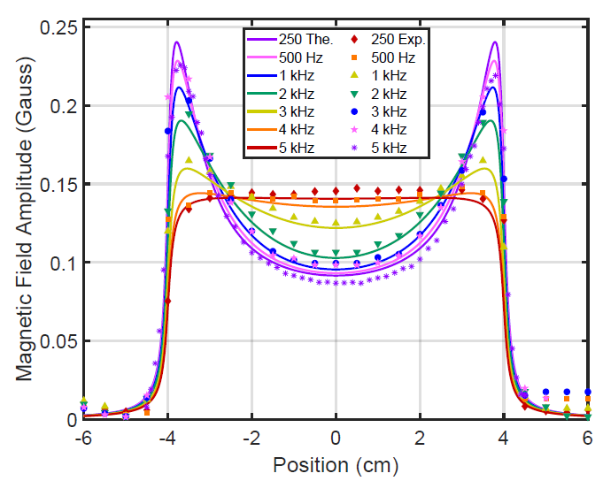
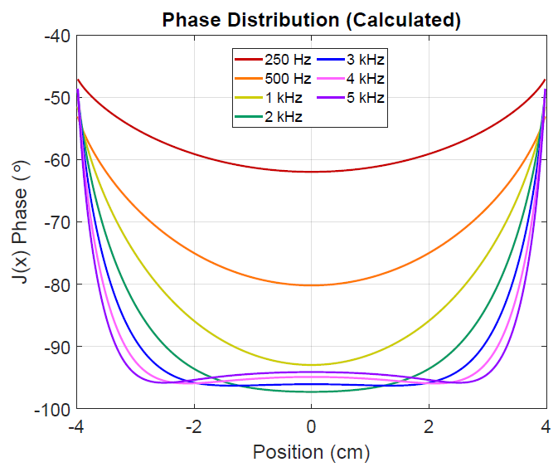
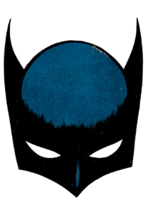
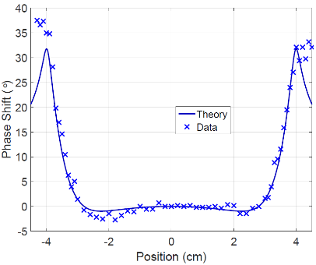
Simulations of traps
Simulate 2-D magnetic fields from finite-size current traces
Trap location, depth, curvature
Plan / iterate with sizes, currents
Include skin effect for accuracy
Proximity effect between wires
phase
…Batman
amplitude
Blackwell, Anne E., Andrew P. Rotunno, and Seth Aubin. "Demonstration of the lateral AC skin effect using a pickup coil." American Journal of Physics 88.8 (2020): 676-684.

Slide 30


Proof of trapping
|2, +2 ⟩
|2, -2 ⟩
View from side, after hold time
Recall ODT confines atoms axially
Demonstrate that we trapped high-field seeking m_{F} states (!)
Twice as many trappable states
New experiments allowed
Can trap absolute ground state |1,+1 ⟩

Slide 31




Trap Oscillations
|2,2⟩
|1,1⟩
|2,-2⟩
|1,-1⟩
While trapped, pulse DC current on Z-wire
Atoms oscillate, then we drop
Diagonal S-G impulse, in-trap
Trap freqs ω_{F=1}: ω_{F=2} roughly $1:\sqrt{2}$
Compare to simulation fits
Opposite detuning, phase for each of these four traps

Slide 32


Trap frequencies
Tightest on resonance (low δ)
Linear at bottom, not harmonic
Red/Blue δ tragedy
Hypothesis: B_{DC} curvature on
mF = +2 vs. -2
Compare measured spatial osc.
to simulated E_{ACZ} trap bottom
X symmetric, Y asym (1/r + grav.)
Trap freq.∝ Ω ∝ |B±| ∝ $\sqrt{P}$

Slide 33

Trap lifetimes
Data with no model (yet)
Low trap lifetime on resonance
Like earlier state mixing
Structure close-in
We didn’t see atoms in |+⟩
Suggests thermal losses dominate
We had expected this spin flip
High power: tighter trap freq.
Temp competes with depth (?)

Slide 34

Position control
Phase moves atoms up-down (in two-wire arrangement)
Current ratio in wires moves trap left-right (in an arc)
(estimated phase)

Slide 35


Evaporation
Three forms of evaporation:
RF knife (conventional)
Microwaves (F=2 → 1)
Phase: up to chip surface and back
Each lowered temperature
Only modest PSD improvements
One day, could get BEC in trapped |2, -2 ⟩ state, or m_{F}=0
Double dressing →
Adiabatic RF-RF/µw potentials
New AI methods

Slide 36
Table of contents
Motivation
Introduction
AC Zeeman Theory
ACZ Force
ACZ Trapping
Trap simulation
Summary / Outlook – Past and Future

Slide 37


Summary – We trapped!
Using less than 1 watt of RF power
100’s of Hz trap frequency
½-second lifetime off resonance
Odd features: red-blue asymmetry
Due to m_{F} in ext. B_{DC} field?
Due to chip coupling phase?
Overlooked physics?
Harmonics / RWA approximation
Lifetime explanation?
Decent agreement of data + theory for RF AC Zeeman anyway

Slide 38

Next steps for trapping and chip design
Move to microwaves (6.8 GHz)
Target spin states inter-manifold
With polarization AND detuning
Microstrips (add ground plane)
simulate with EM solvers (FEKO)
Use standing-wave longitudinal lattice for axial control
Design three-wire traps
For single-frequency AI
Can also use multiple freq. in arbitrary arrangements
Credit: W. Miyahira

Slide 39


Proposed 3-Wire Atom Interferometer
Middle wire reversed (180°) forms a trap
Phase shift separates +/- left-and-right
Imagine clock states |2,1 ⟩ & |1,-1 ⟩ as the interferometer arms
F=1 trap
210°
F=2 trap
210°
180°

Slide 40




Thank you!
Advisor
Seth Aubin
Current Ph.D. Students William
Shuangli Du Miyahira
Defense Committee
Eugeniy Mikhailov
Keith Griffioen
Todd Averett
Nathan Lundblad
Past students :
Austin Ziltz, Charlie Fancher, Anuraag Sensharma
(Seth), Julia Stone, Megan Ivory, AJ Pyle
Undergrads: Annie Blackwell
And all the FEKO squad

Slide 41



Rabi Gradients
Observe rather directly:
Watch atoms “flop” in slow-mo
(not a push here, just seeing field)
Bright/dark lines in Atoms are contour lines in Rabi frequency
Gradients will push or pull atoms toward or away from the source
(for a single wire)

Slide 42
Throw and catch
Throw: Phase brings |++ ⟩ upward, as power turns off and δ goes red
Microwave sweep |2,2 ⟩ → |1,1 ⟩ (as RF flips phase and δ red to blue)
Catch: Sweep RF in from above, catch |+’ ⟩
This is how we trap F=1

Slide 43


Microwave lattice

Slide 44



Measuring Rabi frequency

Slide 45


Slide 47



2-wire, 2-microstrip, for r_{RL}=1

Slide 48




2-wire, 2-micro: Trap bottoms over phase, r_{RL}

Slide 49




3-wire, 3-micro: Trap bottoms over phase, r_{M}

Slide 50



Slide 51


C. Fancher’s thesis

Slide 52

What’s a force good for? (from Charles Fancher)
You can push or pull a single spin
with microwave
RF affects all intra-manifold states
Imagine:
Sympathetic cooling (by atom species or spin state)
Nudge one spin of a mixture
Shift one lattice site energy
Shuangli made a Clock / AI
Greater than gravity, can trap…

Slide 53


Fluffy

Slide 54


90° 2-wire case (red backwards, test gif)

